Slide 1
Intelligent Agents

Slide 2
Outline
Agents and environments
Rationality
PEAS (Performance measure, Environment, Actuators, Sensors)
Environment types
Agent types

Slide 3
Agents (rational agents)
An agent is anything that can be viewed as perceiving its environment through sensors and acting upon that environment through actuators
Human agent: eyes, ears, and other organs for sensors; hands,legs, mouth, and other body parts for actuators
Robotic agent: cameras and infrared range finders for sensors;various motors for actuators

Slide 4
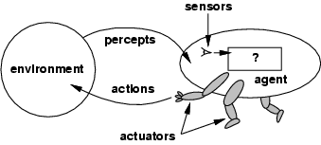
Agents and environments
Percept: refer to the agents perceptual input at any given instant.
The agent function maps any given percept sequence to an action [f: P* 🡪 A] Agent function will be implemented by agent program
The agent function is an abstract mathematical description ; agent program is a concrete implementation, running on agent architecture

Slide 5
Percept : input at given instance
Percept sequence : complete history
Tabulating the agent function that describes any given agent (for most agent it will be a long table)
Given an agent to experiment with, we can in principle construct this table by trying out all possible percept sequence and recording which actions the agent does in response

Slide 6
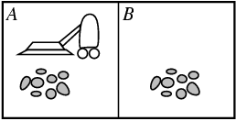
Vacuum-cleaner world

Slide 7
Vacuum-cleaner world
Percepts: location and contents, e.g., [A,Dirty]
Actions: Left, Right, Suck, NoOp
Input
Output

Slide 8
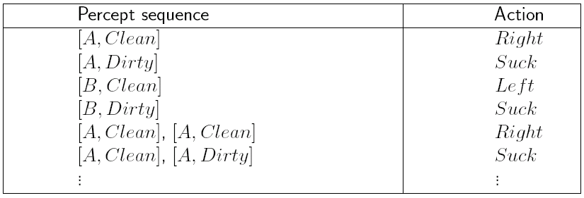
Example: Vacuum Cleaner Agent
Percepts: location and contents, e.g., [A, Dirty]
Actions: Left, Right, Suck, NoOp
history : complete sequence agent has perceived
‹#›

Slide 9
Rational agents
An agent should strive to "do the right thing", based on what it can perceive and the actions it can perform. The right action is the one that will cause the agent to be most successful
Performance measure: An objective criterion for success of an agent's behavior
E.g., performance measure of a vacuum-cleaner agent could be amount of dirt cleaned up, amount of time taken, amount of electricity consumed, amount of noise generated, etc.

Slide 10
Rational agents
Rational depend on :
The performance measure that defines degree of success.
What the agent knows about the environment.
The actions that the agent can perform.(Actuator)
The agent's percept sequence to date (Sensors)
Def : Rational Agent: For each possible percept sequence, a rational agent should select an action that is expected to maximize its performance measure, given the evidence provided by the percept sequence and whatever built-in knowledge the agent has.

Slide 11
Rational agents
Rationality is distinct from omniscience (all-knowing with infinite knowledge)
Omniscience agent knows the actual outcome of its action and act accordingly
Agents can perform actions in order to modify future percepts so as to obtain useful information (information gathering, exploration) learning
An agent is autonomous if its behavior is determined by its own experience (with ability to learn and adapt)

Slide 12
Specifying the task environment
Task Environment : essentially the “problems” to which rational agent are the “solution”
We have to specify the : Performance measure, Environment, Actuators, Sensors(PEAS)

Slide 13
PEAS
Automated taxi driver
Medical diagnosis system
Part-picking robot
Interactive English tutor

Slide 14
PEAS
Must first specify the setting for intelligent agent design
Consider, e.g., the task of designing an automated taxi driver:
Performance measure: Safe, fast, legal, comfortable trip, maximize profits
Environment: Roads, other traffic, pedestrians, customers
Actuators: Steering wheel, accelerator, brake, signal, horn
Sensors: Cameras, sonar, speedometer, GPS, odometer, engine sensors, keyboard

Slide 15
PEAS
Agent: Medical diagnosis system
Performance measure: Healthy patient, minimize costs, lawsuits
Environment: Patient, hospital, staff
Actuators: Screen display (questions, tests, diagnoses, treatments, referrals)
Sensors: Keyboard (entry of symptoms, findings, patient's answers)

Slide 16
PEAS
Agent: Part-picking robot
Performance measure: Percentage of parts in correct bins
Environment: Conveyor belt with parts, bins
Actuators: Jointed arm and hand
Sensors: Camera, joint angle sensors

Slide 17
PEAS
Agent: Interactive English tutor
Performance measure: Maximize student's score on test
Environment: Set of students
Actuators: Screen display (exercises, suggestions, corrections)
Sensors: Keyboard

Slide 18
Environment types
Fully observable (vs. partially observable): An agent's sensors give it access to the complete state of the environment at each point in time.
Deterministic (vs. stochastic): The next state of the environment is completely determined by the current state and the action executed by the agent. (If the environment is deterministic except for the actions of other agents, then the environment is strategic)
Episodic (vs. sequential): The agent's experience is divided into atomic "episodes" (each episode consists of the agent perceiving and then performing a single action), and the choice of action in each episode depends only on the episode itself.

Slide 19
Environment types
Static (vs. dynamic): The environment is unchanged while an agent is deliberating. (The environment is semidynamic if the environment itself does not change with the passage of time but the agent's performance score does)
Discrete (vs. continuous): A limited number of distinct, clearly defined percepts and actions.
Single agent (vs. multiagent): An agent operating by itself in an environment.

Slide 20
Environment types
Chess with Chess without Taxi driving
a clock a clock
Fully observable Yes Yes No
Deterministic Strategic Strategic No
Episodic No No No
Static Semi Yes No
Discrete Yes Yes No
Single agent No No No

Slide 21
Environment types
Chess with Chess without Taxi driving
a clock a clock
Fully observable Yes Yes No
Deterministic Strategic Strategic No
Episodic No No No
Static Semi Yes No
Discrete Yes Yes No
Single agent No No No
The environment type largely determines the agent design
The real world is (of course) partially observable, stochastic, sequential, dynamic, continuous, multi-agent

Slide 22
The structure of Agent
The job of AI is to design the agent program: that implement the agent function mapping percepts to actions. We assume this program will run on some sort of computing device, which we will call the architecture.
In general, the architecture makes the percepts from the sensors available to the program, runs the program, and feeds the program's action choices to the effectors as they are generated.
agent = architecture + program
function TABLE-DRIVEN-AGENT(percept) returns action
static: percepts, a sequence, initially empty
table, a table of action, indexed by percept sequences, initially fully specified
append percept to the end of percepts
action <— LOOKUP(percepts, table) return action
Agent Program :Keeps track of percept sequence and use it to index into a table of action.
The table represent explicitly the agent function that agent program embodies

Slide 23
Table-lookup agent
Drawbacks:
Huge table
Take a long time to build the table
No autonomy
Even with learning, need a long time to learn the table entries.
The key challenge for AI is to find out how to write programs that to the extent possible produce rational behavior from small amount of code rather than large number of table entries.

Slide 24
Agent types/Program
Four basic types in order of increasing generality:
Simple reflex agents
Model-based reflex agents
Goal-based agents
Utility-based agents
Learning agent

Slide 25
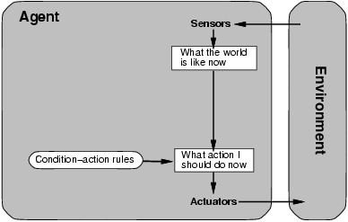
Simple reflex agents
We use rectangle to denote the current internal state of the agents decision
process and ovals to represent the background information used in the process

Slide 26
Simple Reflex Agent
function SiMPLE-REFLEX-AGENT(Percept)returns action
static: rules, a set of condition-action rules
state <— lNTERPRET-lNPUT(percept)
rule <- RULE-MATCH(state, rules)
action <- RULE-ACTiON[rule]
return action
It acts according to a rule whose condition matches the current state as defined by percept.

Slide 27
Simple Reflex Agent
The simplest Kind of agent, agent select actions on the basis of the current percept, ignoring the rest of the percept history.
Vacuum Cleaner – based on current location and on whether that contains dirt
Car driving: if the car in front brakes, and its brake lights come on, then the driver should notice this and initiate braking. condition-action rule if car-in-front-is-braking then initiate-braking.
Issues
If decision can be made on the basis of current percept i.e only If the environment is fully observable.
sensors do not provide access to the complete state of the world. In such cases, the agent may need to maintain some internal state information
Infinite Loop: due to partially observable environment.

Slide 28
function REFLEX_VACUUM_AGENT([LOCATION,STSTUS]) returns an action
if STATUS = Dirty then return Suck
else if location = A then return Right
else if location = B then return Left

Slide 29
Model based reflex agents
Agent to keep track of the part of the word it cant see now.
Maintain some sort of internal state that depend on the percept history and thereby reflect at least some of unobservable aspect of current state.
Updating this internal state information as time goes by requires two kinds of knowledge to be encoded in the agent program.
we need some information about how the world evolves independently of the agent—for example, that an overtaking car generally will be closer behind than it was a moment ago.
we need some information about'how the agent's own actions affect the world—for example, that when the agent changes lanes to the right, there is a gap (at least temporarily) in the lane it was in before, or that after driving for five minutes northbound ; on the freeway one is usually about five miles north of where one was five minutes ago.

Slide 30
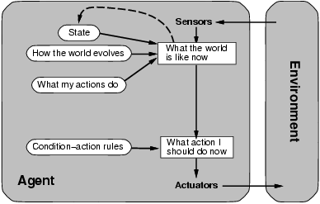
Model-based reflex agents
Current percept is combined with old internal state to generate the updated
description of the current state.

Slide 31
Model-based reflex agents
Function Reflex agent with state returns an action
static:
state <— Update-state(state,action,percept)
rule <- RULE-MATCH(state, rules)
action <- RULE-ACTiON[rule]
return action
Update state is responsible for creating the new internal state description as well as interpreting the new percept in the light of existing knowledge about the state.

Slide 32
Action may depend on history or unperceived aspects of the world.
− Need to maintain internal world model.
Example:
Agent: robot vacuum cleaner
Environment: dirty room, furniture.
Model: map of room, which areas already cleaned.
Sensor/model trade-off.

Slide 33
Goal-based agents
Knowing about the current state of the environment is not always enough to decide what to do. For example, at a road junction, the taxi can turn left, right, or go straight on. The right decision depends on where the taxi is trying to get to.
Agent needs some sort of goal information, which describes situations that are desirable for example, being at the passenger's destination.
Agent Program choose the action that achieve the goal
Searching and Planning are the subfields of AI devoted to finding action sequence that achieve the agents' goal.
Decision making is different from condition-action rule
Reflex agent use built in rule to map percept to action , Goal based could reason
Although the goal based agent appeared less efficient it is more flexible because knowledge that support its decision is represented explicitly and can be modified.

Slide 34
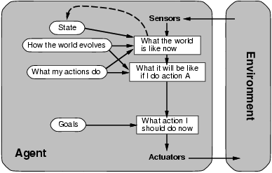
Goal-based agents

Slide 35
goal-based agent
def action (agent, environment):
let state = agent. s e n s e (environment)
for action in agent.available Actions :
let resultingState = agent.do (action, state)
if resultingState == agent. goal:
return action

Slide 36
Utility-based agents
Goals alone are not really enough to generate high-quality behavior.
action sequences that will get the taxi to its destination, thereby achieving the goal, but some are quicker, safer, more reliable, or cheaper than others.
Utility is therefore a function that maps a state onto a real number.
A complete specification of the utility function allows rational decisions in two kinds of cases where goals have trouble:
when there are conflicting goals only some of which can be achieved (for example, speed and safety), the utility function specifies the appropriate trade-off.
when there are several goals that the agent can aim for, none of which can be achieved with certainty, utility provides a way in which the likelihood of success can be weighed up against the importance of the goals.

Slide 37
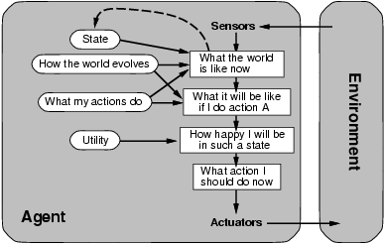
Utility-based agents

Slide 38
def action ( agent , environment ) :
let state = agent . sense ( environment )
let maxUtility = −Infinity
let maxUtility State = None
for action in agent.available Actions :
let resulting State = agent. do (action, state)
let resulting StateUtility = agent. getUtility ( r e s u l t i n g State )
if resulting StateUtility > maxUtility :
maxUtility = resulting StateUtility
maxUtility State = resulting State
return maxUtility State

Slide 39
Learning agents
All agents can improve their performance through learning
Learning element-which is responsible for making improvement
Performance element-selecting external actions: it takes percepts and decide on actions
Critic how agent is doing and how the performance should be modified to do better.
Problem generator suggest exploratory actions that lead to new and informative experiences.
Critic tells the learning element how well the agent is doing w.r.t performance standard

Slide 40
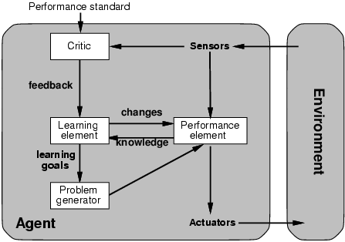
Learning agents

Slide 41
Compare
A simple reflex agent. It works by finding a rule whose condition matches the current situation (as defined by the percept) and then doing the action associated with that rule.
A reflex agent with internal state. It works by finding a rule whose condition matches the current situation (as defined by the percept and the stored internal state) and then doing the action associated with that rule.
Goal based keep track of world state as well as set goal it is trying to achieve and choose an action that will lead to achievement of its goal
Utility based uses utility function that measures its preferences among states of the world and chooses the action that leads to the best expected utility. Expected utility is calculated by averaging all possible outcome state, weighted by probability of outcome .

Slide 42
For each of the following agents develop a 1. PEAS description of task environment ,
2. Environment type and
3. Write agent
Robot Soccer Player
Internet book shopping agents
Autonomous Mars rover
Mathematician’s theorem proving assistant
Notes:
http://webpage.pace.edu/aa10212w/course/CS827/assignments/unit1/hw1.html

